Slide 1
M269 Algorithms, data structures and computability
Introduction to the module
October 2024
The tutorial is due to begin at 19:00 and last for one and a half hours
While you wait, please run the audio set up wizard
You are welcome to use your microphone during the tutorial, please remember:
lf you are not using a headset, make sure that there is no feedback to your mic from your computer’s speakers
Keep your mic away from sources of external noise such as fans, for example
If you can, please keep your mic muted when you are not speaking

Slide 2
M269 Algorithms, data structures and computability
Dr James Burton
Introduction to the module
October 2024

Slide 3

01
Overview
A look at the module and each block
02
Software
Module specific software: Python, Jupyter notebooks
03
Assessment
An overview of the TMAs and EMA
04
Support
Your tutor, tutorials, forums and additional support
05
Checklist
Where are you up to, what should you be doing next
06
Q&A
An opportunity for questions and discussion

Slide 4
Overview

Slide 5
Overview
M269 Website Resources area
Forums
Tutor & Cluster Forums
Block Forums
News area
Resources
M269 Book
Module Guide
Jupyter Hub
Visualisations
Module structure
Study calendar (Accessible from Block 1 or resources)
TMA/EMA dates
Cross reference with other modules
OU Study app

Slide 6
Overview
M269 Book
Provides the teaching materials for the entire module
Available in several formats: PDF, HTML and Jupyter notebooks
The notebooks make this an interactive resource: experiment with code, complete the exercises
If you use several devices upload a copy to Jupyter Hub, your own playground for running notebooks and Python code
It is a big book. Look at the TMAs before working through the corresponding chapters to gauge what to study in depth, what to skim and what to skip.

Slide 7
Overview
Module Guide
Covers the aims and outcomes of the module
Explains the structure of the module
Explains how the module is assessed
Provides guidance on the word count rules for the module
Module Guide: 5.2 Word counts and referencing (open.ac.uk)
Explains plagiarism and referencing
Remember to provide citations and references
Cite them right
Quick guide to Harvard referencing (Cite Them Right) | Library Services | Open University

Slide 8

Overview
Forums, News & Resources
Cluster Forums
M269 Discussion Forum
Café Forum
Block Forums
Discussion
Software support
News
Errata!
News feed
Resources tab
Module guide
Jupyter Hub
Visualisation of data structures and algorithms
Chapter quizzes

Slide 9
Overview
Module structure
M269 is a 30-credit module over 30 weeks, so expect to work for an average of 10 hours per week.
If you’re studying part-time, I strongly advise you to do at most one other 30-credit module in parallel to M269.
Each week usually corresponds to one book chapter.
The material gets progressively harder, so early weeks like this one don’t require 10 hours to read and work through, while others may require more.
Get ahead of the study planner whenever you can.

Slide 10
Overview
Module structure
Three blocks, based on the book
Numbers and sequences
Search, sorting, trees and graphs
Complexity and computability
Three TMAs
Linked to each block
Written responses required but mostly technical: code, algorithms and technical specifications
Equal weighting
No EMA (but TMA03 is treated like an EMA)

Slide 11
Overview
Block 1
Block 1: Basic data structures and algorithms, Weeks 1-11
Numbers and sequence
Booleans and selection
Sequence and iteration
TMA01 Part 1
Implementing sequences
Stacks and queues
Unordered collections
TMA01 Part 2
Work on the exercises from the book throughout

Slide 12
Overview
Block 2
Block 2: Search, sorting and more data structures, Weeks 12-23
Exhaustive search
Recursion
Divide and Conquer
Sorting
TMA02 Part 1
Trees
Graphs
Greedy algorithms
TMA02 Part 2

Slide 13
Overview
Block 3
Block 3: More algorithms, computability and complexity, Weeks 24-30
More graphs
Backtracking
Dynamic programming
TMA03 Part 1
Complexity classes
Computability
TMA03 Part 2

Slide 14
Overview
Visualisations can be really helpful!
See also https://www.cs.usfca.edu/~galles/visualization/Algorithms.html
Have a go at all of the exercises and chapter quizzes.

Slide 15
Overview
Where would you look for extra guidance on Python programming?
Ask your tutor, cluster forum, fellow students
Come to online tutorials
General web search, W3Schools, StackOverflow
Keep practising!

Slide 16



Overview
OU Study App
OU Study is the companion app for OU Module websites
Always have your study planner to hand
Access to your learning materials on the go
Download your learning materials to use offline
OU Study | Apps at the OU (open.ac.uk)

Slide 17
Software

Slide 18
Software
Python 3
Jupyter notebooks
An IDE
You could do all of your work on Jupyter Hub, the online platform for running notebooks.
Better to have everything set up locally too – more flexible, more responsive, works offline.

Slide 19
Software
Explained in the book, Chapter 1.3.
To install Jupyter on your machine, follow the instructions on
https://dsa-ou.github.io/m269-installer.
Following this process will ensure that you have the right versions of Python and the libraries you need.
It also installs the tool allowed.py, which will warn you if you use any Python features not covered on the module. If you do this you will lose marks!

Slide 20
Software
DEMO

Slide 21
Assessment

Slide 22
Assessment
Full study calendar available on module website under Resources tab
Three TMAs, weighted 30%, 30% and 40% (in this order)
You must submit TMA03 (even if you only put your name on it) or you cannot pass the module
No extension for TMA03

Slide 23
Assessment
Content of TMAs
Each TMA requires you to demonstrate understanding and learning by:
Writing code
Explaining your choice of data structures and algorithms
Producing technical specifications of problems and solutions

Slide 24
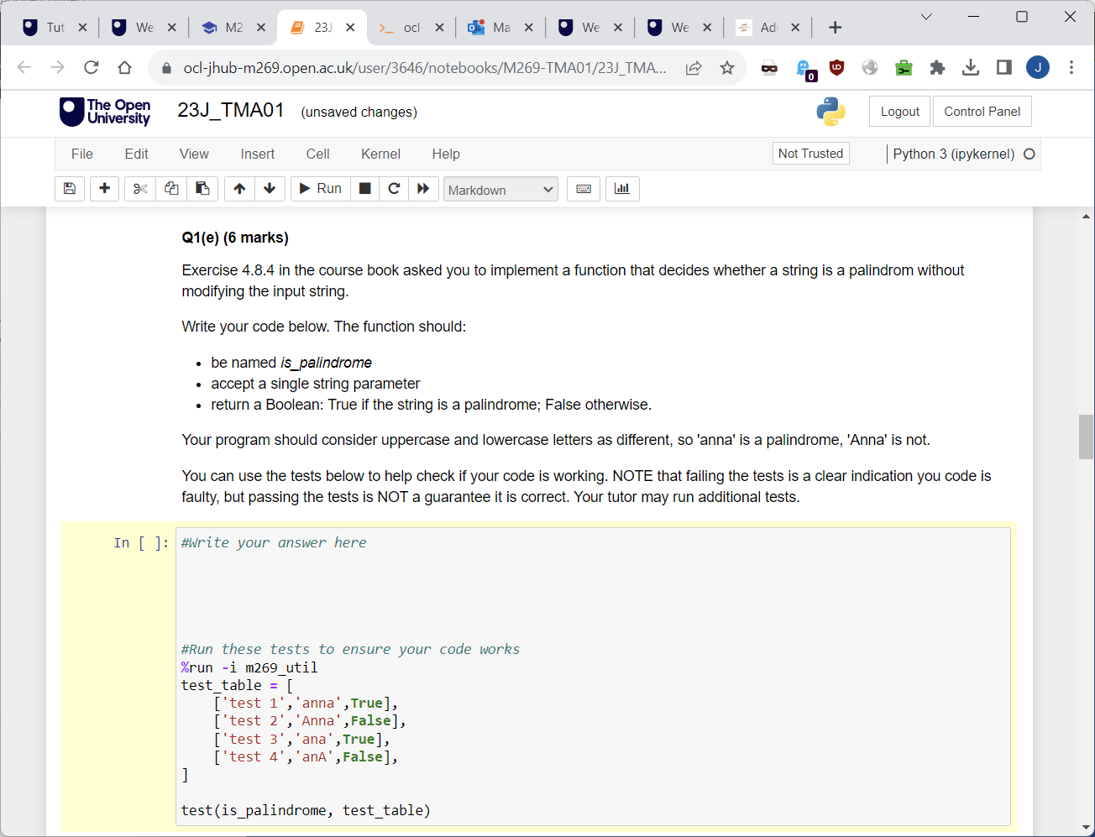
Assessment

Slide 25
Assessment
If it is found that you have used the services of a website, online service or social media platform, or that you have otherwise obtained the work you submit from another person, this is considered serious academic misconduct.

Slide 26
Support

Slide 27
Support
Tutor
Ask for help and advice when needed
TMA feedback
Tutorials
Most have a specific theme: search, sorting, trees etc
TMA ‘Don’t panic’ sessions
EMA sessions
Q&A sessions (questions submitted in advance)
Attend any you want/need to
Some will be recorded
Forums
Library services

Slide 28
Support
Study Tips
Follow the study calendar
Designate study time
Complete practical activities as they come up
Read through the TMAs as soon as you get to that block
Save work regularly – use OneDrive/Microsoft 365 for automatic saving and version history

Slide 29



ousa@open.ac.uk
Community
Meet other students
Join a Society
Create a Club
Apply for University Challenge
Sign up for news
Volunteering opportunities
Visit our OU shop
Support
Talk to a Peer Supporter
Contact Nightline
Explore Togetherall
Disabled Students Group
BAME students Group
PLEXUS (LGBT+) Group
Mental Health Resources
Help and Guidance
Representation
Find out how the Association represents you
Want to feedback to the OU?
Represent your fellow students in OU meetings
Find out about all these and more at www.oustudents.com

Slide 30
Checklist
Notes:
Where is everyone up to?

Slide 31
What next
Download study calendar and the book
Make a note of important dates
Install the module software (Python 3 etc) and an IDE of your choice
Read TMA 01

Slide 32
Q&A

Slide 33
Thanks for taking part and I hope you have fun!

